Slide 1
Fourier Ptychographic Microscopy
(FPM) with Raspberry Pi
Project Plan Presentation
Team Members: Apurva Kulkarni · Shlok Khaire
Chair for Computational Sensing & Communications Engineering
Universität Siegen

Slide 2
Presentation Overview
2 / 8
01
02
Project Title & Summary
Background & Significance
Problem statement, motivation, and expected learning outcomes.
Why FPM is challenging, useful, and research-relevant.
03
04
Resources & Setup
Goals & Deliverables
Hardware, software, reconstruction pipeline, and current prototype.
Plan to achieve , hope to achieve , weekly schedule and results.
CHAIR FOR COMPUTATIONAL SENSING & COMMUNICATIONS ENGINEERING · SIEGEN UNIVERSITY

Slide 3
Project Title & Summary
3 / 8
Fourier Ptychographic Microscopy
Summary
This project aims to build a low-cost, miniature Fourier Ptychographic Microscope using a Raspberry Pi, a standard camera module, and a programmable LED array. By capturing a sequence of images under varying illumination angles and applying a computational reconstruction algorithm, we will learn how to bypass the physical resolution limits of a lens to achieve high-resolution, wide-field-of-view digital imaging.
Problem Statement
Expected Learning Outcomes
Traditional microscopy is limited by a trade-off where lenses cannot provide both high resolution and a wide field of view simultaneously. This project overcomes this barrier by using low-cost hardware and computational imaging to achieve sub-micron resolution across a large area in a portable, affordable format.
This project provides hands-on experience in computational imaging by implementing phase-retrieval algorithms to synthesize high-resolution images from Fourier-domain data.
CHAIR FOR COMPUTATIONAL SENSING & COMMUNICATIONS ENGINEERING · SIEGEN UNIVERSITY

Slide 4
Background & Significance
4 / 8
Why FPM is Challenging
— Requires accurate LED calibration to ensure accurate illumination angles.
— Reconstructions are highly sensitive to external noise, such as ambient light interference and mechanical vibrations in the 3D-printed frame.
— Exposure balancing between LEDs.
Why FPM is Useful
— Achieves high-definition imaging with a low-NA objective — field of view and resolution simultaneously
— Unlike standard bright-field microscopy, FPM allows for the recovery of the sample's phase information.
— We can computationally correct lens distortions and blurring by performing reconstructions in the Fourier domain.
Research Relevance
— Building on the foundational "Frequency Stitching" methods to move toward faster, more robust phase retrieval.
— Combines optical physics, Python programming, and signal processing—the core pillars of modern computational sensing.
— This setup serves as a baseline for future explorations into deep-learning-based image enhancement.
CHAIR FOR COMPUTATIONAL SENSING & COMMUNICATIONS ENGINEERING · SIEGEN UNIVERSITY

Slide 5
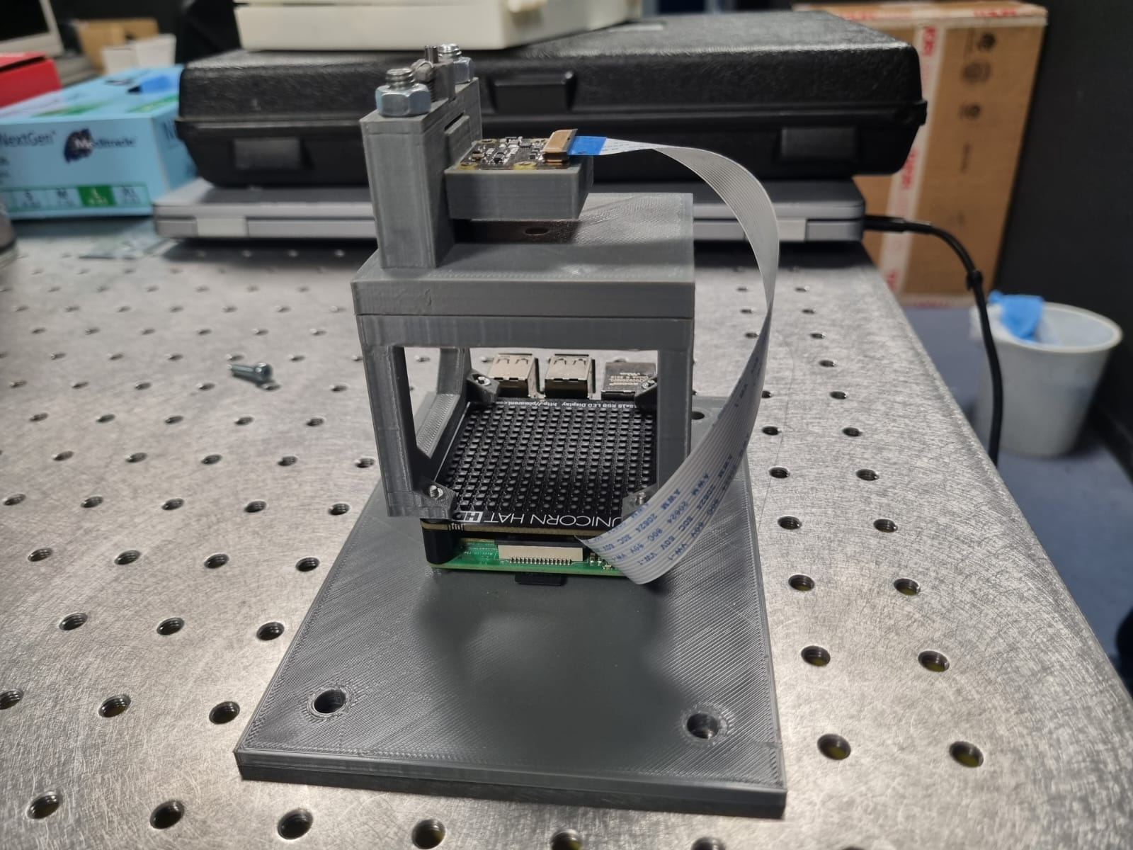
Resources & Setup
5 / 8
Hardware
Raspberry Pi (compute + LED control)
Unicorn HAT HD — 16×16 LED matrix for angle-varying illumination.
Raspberry Pi Camera 2 Module.
3D-printed optical mount and alignment fixture.
Software & References
Python(picamera2, unicornhathd)
Low-cost, sub-micron resolution, wide-field computational microscopy using open-source hardware by Aidukas et. al.
Miniature Fourier ptychography microscope using Raspberry Pi camera and hardware by Konda et. al.
Low-Cost Fourier Ptychography Microscope Kit by Guzmán et. al.
Current prototype — Raspberry Pi + Unicorn HAT HD + Camera Module on optical mount
CHAIR FOR COMPUTATIONAL SENSING & COMMUNICATIONS ENGINEERING · SIEGEN UNIVERSITY

Slide 6
Goals & Deliverables
6 / 8
Plan to Achieve
Hope to Achieve
Placement mechanism for correct and repetitive placement of slide below the camera.
Robust Denoising: Integrate software filters to computationally remove camera grain and improve SNR while preserving sample features from low-light signals.
Python script to automate the sequential triggering of the LED matrix and synchronized camera captures.
Implementation of a basic FPM algorithm to reconstruct a high-resolution intensity image.
Demonstrable improvement in resolution on a standard target compared to raw images.
A complete project webpage with assembly instructions and a basic user manual.
CHAIR FOR COMPUTATIONAL SENSING & COMMUNICATIONS ENGINEERING · SIEGEN UNIVERSITY

Slide 7
Hardware
7 / 8
Calibration of setup
LED to sample distance ZLED= 60.8mm
Working distance( sample to camera sensor)= 7mm
LED pitch=3.3mm
NAobj=0.095
Pixel size = 1.12 µm × 1.12 µm
Sensor resolution= 3280 × 2464 pixels
Magnification M =1.06 x
CHAIR FOR COMPUTATIONAL SENSING & COMMUNICATIONS ENGINEERING · SIEGEN UNIVERSITY

Slide 8
Software
7 / 8
Pre-Processing Steps
Dark subtract- to remove camera noise
LED distances
LED exposure normalisation
Demosaiced Green channel
Reconstruction
Initialize the high-resolution complex field and pupil function
Apply Fourier Transforms for spatial-to-frequency domain mapping
Enforce amplitude constraints using the captured LED image data
Update the object spectrum and correct aberrations (EPRY)
Iterate the phase retrieval process across all LED illumination angles
Extract the final high-resolution amplitude and phase reconstructions
CHAIR FOR COMPUTATIONAL SENSING & COMMUNICATIONS ENGINEERING · SIEGEN UNIVERSITY

Slide 9
Analysis
7 / 8
Results Achieved
NAobj = 0.15
NAsyn =0.43 for green channel and 9x9 LED illumination.
FOV = 3.06 mm x 2.30mm
Potential Issue
More accurate tuning of exposure
Noise
CHAIR FOR COMPUTATIONAL SENSING & COMMUNICATIONS ENGINEERING · SIEGEN UNIVERSITY

Slide 10
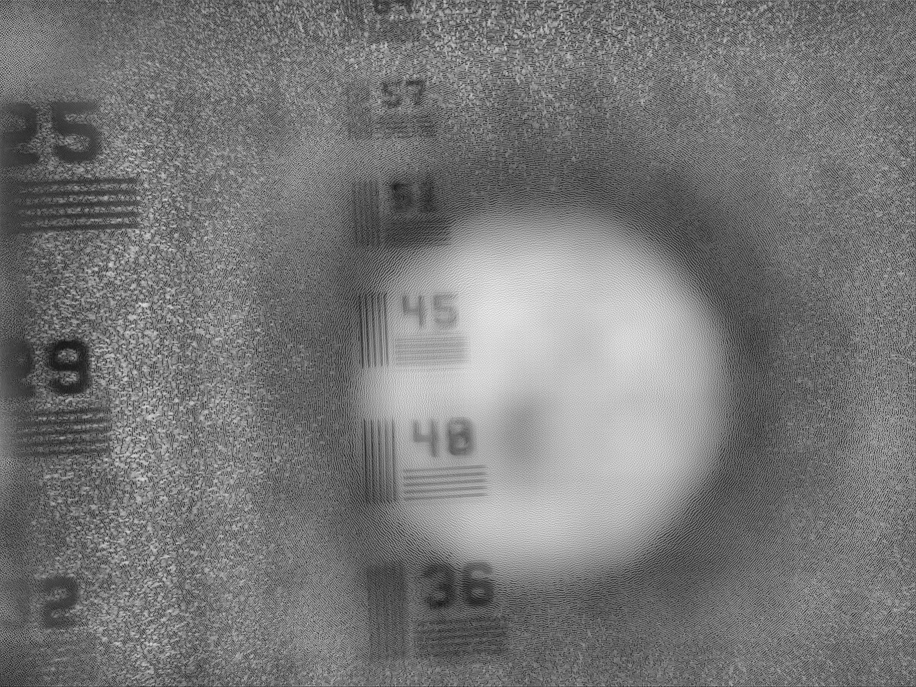
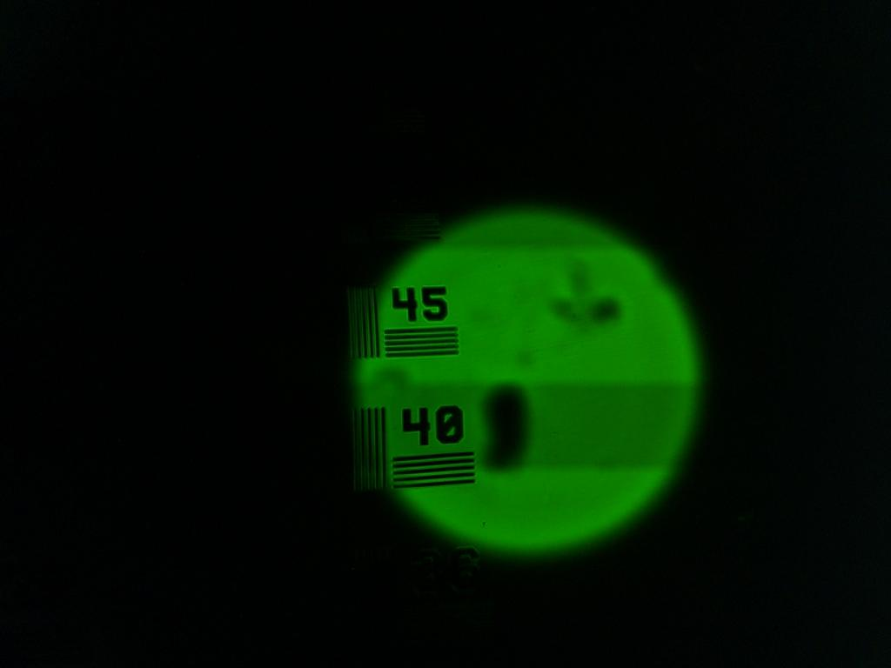
Results
Resolution Target : Input vs Reconstructed image
Bright Field Image
Reconstructed output
Chair for Computational Sensing & Communications Engineering · Universität Siegen

Slide 11
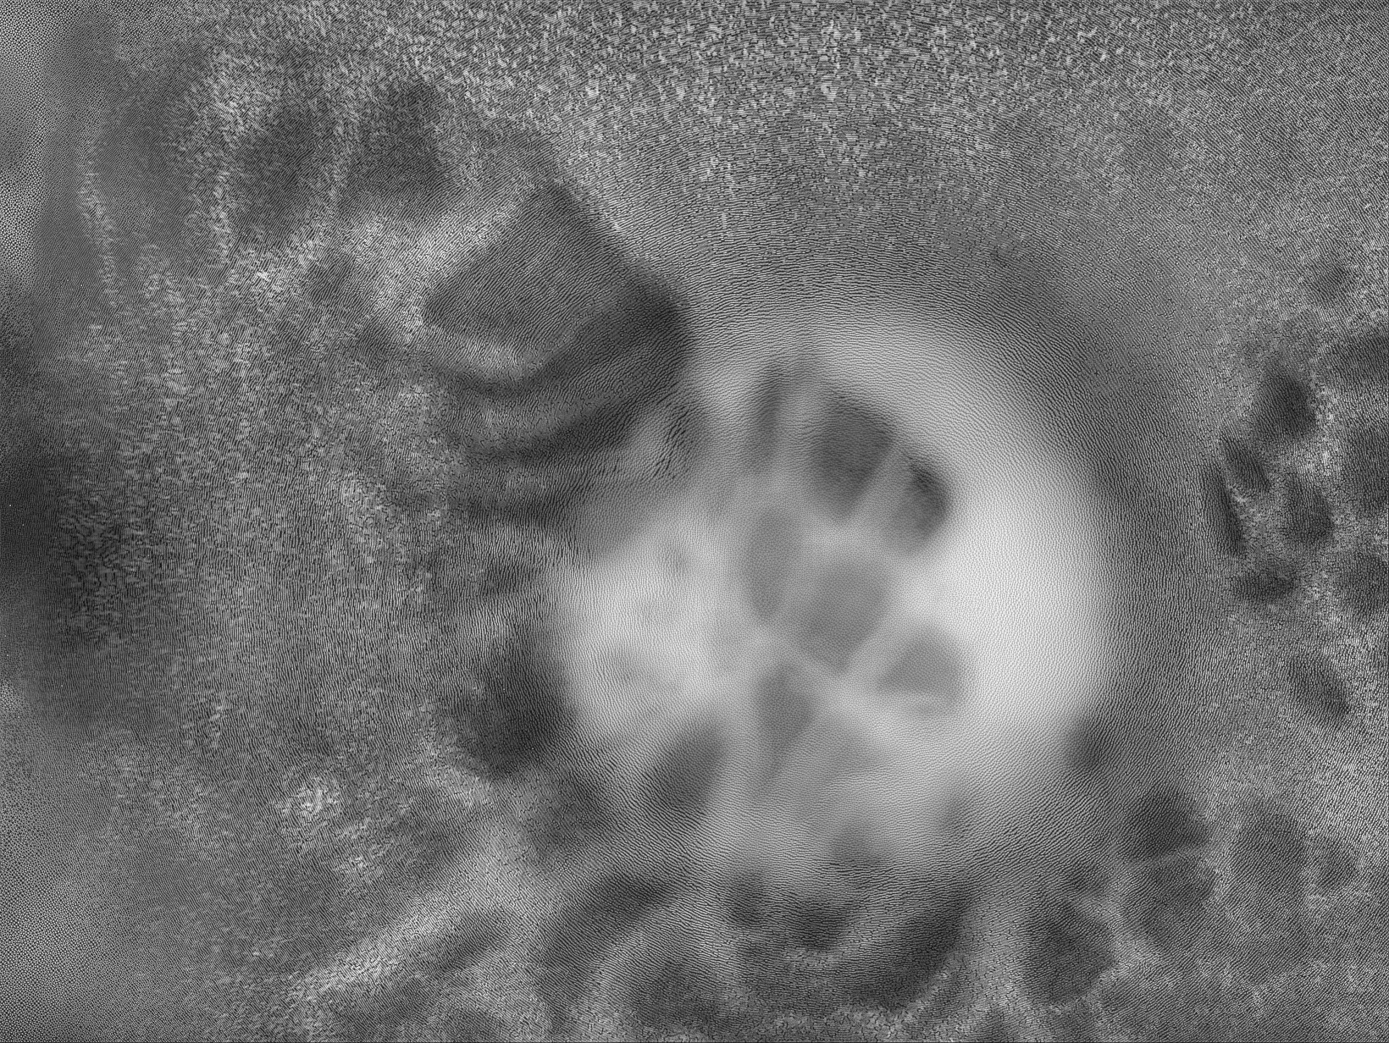
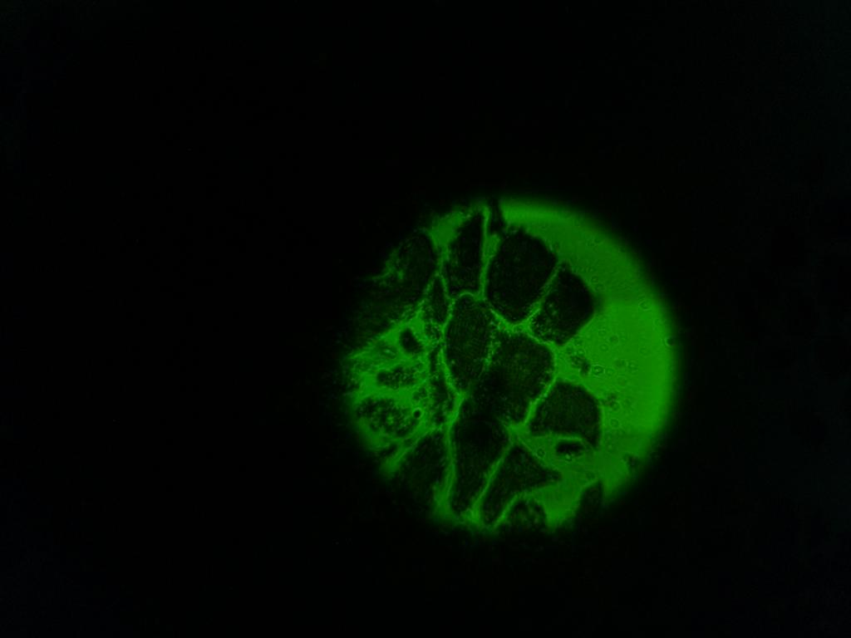
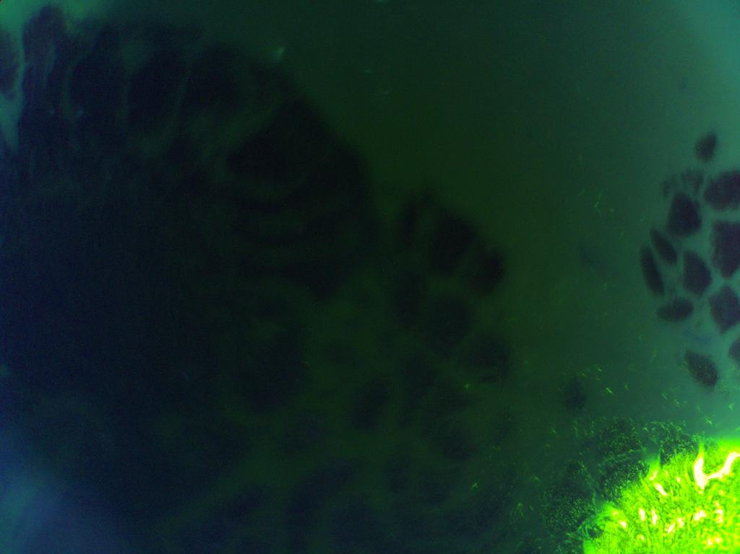
Results
Biological Specimen : Input vs Reconstructed image
Bright Field Image
Dark Field Image
Reconstructed output
Chair for Computational Sensing & Communications Engineering · Universität Siegen

Slide 12
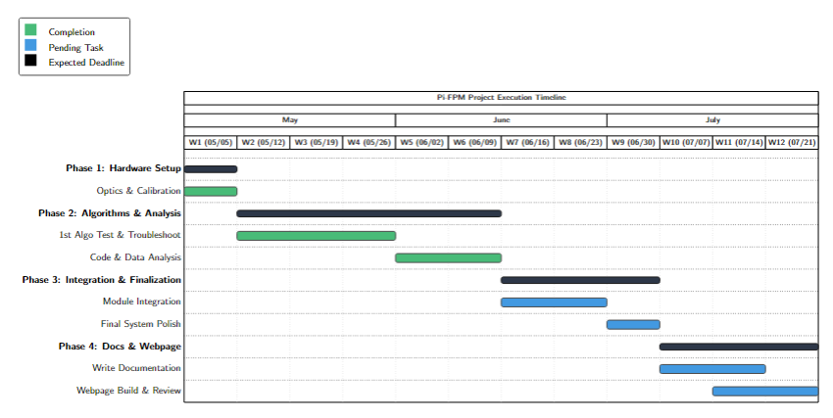
Project Schedule
7 / 8
CHAIR FOR COMPUTATIONAL SENSING & COMMUNICATIONS ENGINEERING · SIEGEN UNIVERSITY

Slide 13
Thank you !
Chair for Computational Sensing & Communications Engineering
Universität Siegen

